Slide 1

Towards a Humane AI Development Framework
Shashwat Vidhu Sher

Slide 2




Introduction
Artificial General Intelligence is the holy grail of technological advancement
If we are building a human-like intelligence, we need to treat AI as a partner rather than as a tool
Human like intelligence will possess human-like values; ignoring this can lead to complications
Three strategies towards a more humane AI development

Slide 3
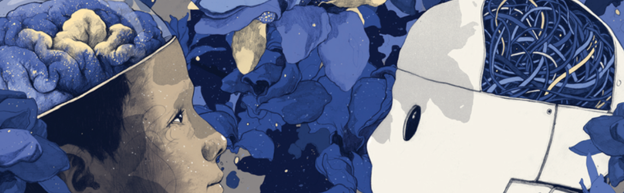
Step 1: AI as our child
Many researchers are looking into child development and borrowing techniques for AI training
Replicate common sense understanding of the world in the same way children do
Children are taught the consequences of their actions by following a framework designed around reward and discipline.
Training AI the same way as our children, helps it understands human values better

Slide 4

Step 2: AI with purpose
AI with human-like intelligence should be allowed to define its own purpose
Intelligent pacemaker that assists heart; learns by understanding its environment
Aligned aims: Pacemaker’s own survival depends on how well it supports the functioning of the heart
By being personally invested, AI is keener to solve unexpected problems

Slide 5

Step 3: AI as our partner
A partnership model inspired by international cooperation
Resource sharing and security
Sanctions and competition to check the power of AGI

Slide 6

Objections and Responses
Objection
Response
AI can develop to have a non-human like intelligence and still be useful in assisting humans for various tasks
How safe is to use artificial agents that have a ‘mind of their own’
Tasks with ethical and moral implications require assistance from an entity that truly understands what is at stake
If properly trained, using AI is as safe or safer than using non-intelligent technology

Slide 7
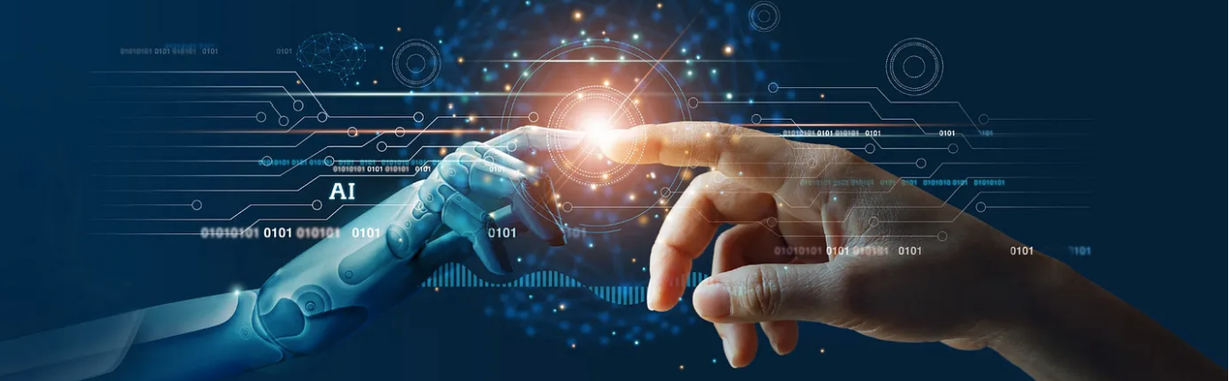
Conclusion
We should aim towards a harmonious co-existence between AI and humans which is only possible when we stop seeing the relationship as master-slave and treat it as a partnership

Slide 8


Thank You

